Slide 1
4. Perceptron & ANN with Tensorflow

Slide 2
Table of Contents
Tensorflow.
Overview.
Perceptron with tensorflow.
Implement ‘AND’ function
With single layer perceptron.
Implement ‘XOR’ function
With multi layer perceptron.
Implement custom neural network.

Slide 3
Tensorflow
Tensor
N-dimensional array.
Like np.array
Tensorflow
Library for machine learning.
From the definion of flow of tensors (data), tensorflow can calcuate gradients of parameters automatically.
There are similar libraries such as Caffe, Torch, …

Slide 4
Tensorflow
Tensor
Variable
Mutable tensor.
For example, weight.
Non-Variable
Immutable tensor.
For example, constant.
Dataflow graph
Parallelism, Distributed execution, Portability, …

Slide 5
Tensorflow exercise
Remind ‘Least Squares’.
Let’s implement least squares with tensorflow.

Slide 6
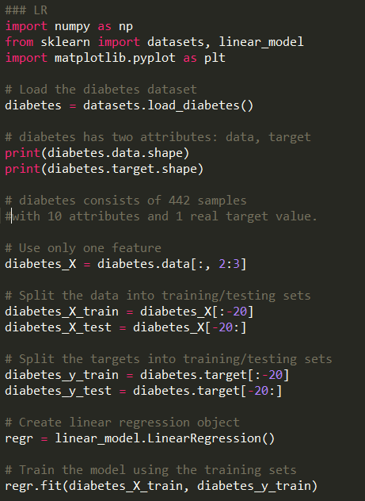
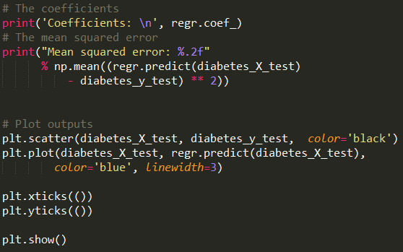
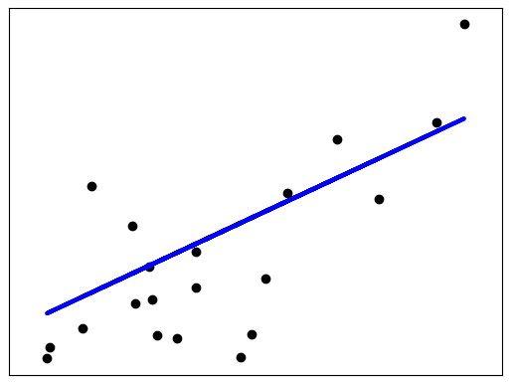
Least Squares Estimation (Linear Regression)

Slide 7
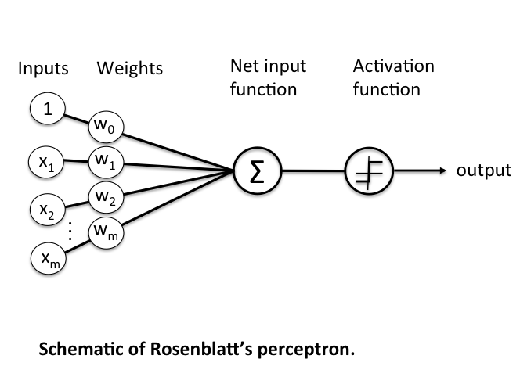
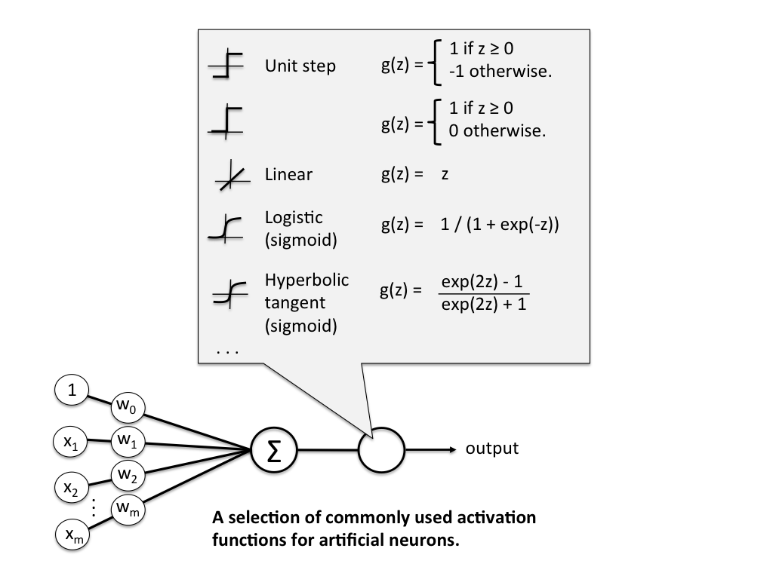
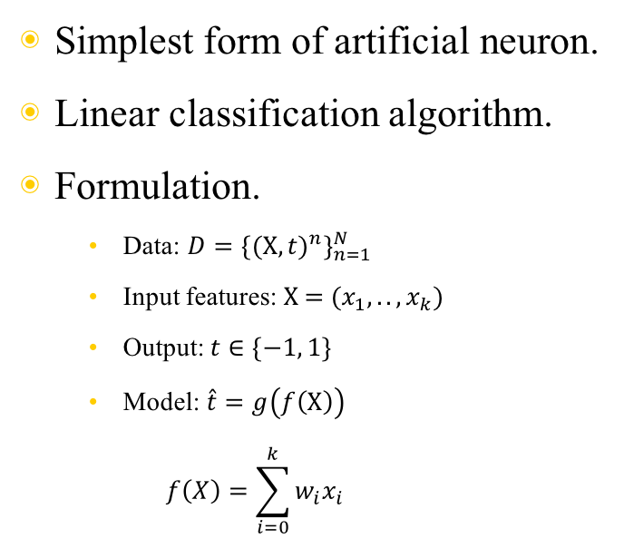
Perceptron(퍼셉트론)
Simplest form of artificial neuron.
Linear classification algorithm.
Formulation.
Data: ${D=\{{(\text{X},t)}^{n}\}}_{n=1}^{N}$
Input features: $\text{X}\text{ = (}x_{1},..,x_{k})$
Output: $t∈\{−1, 1\}$
Model: $\hat{t}=g\left(f\left(\text{X}\right)\right)$ $f\left(X\right)=\sum_{i=0}^{k}{w_{i}x_{i}}$

Slide 8
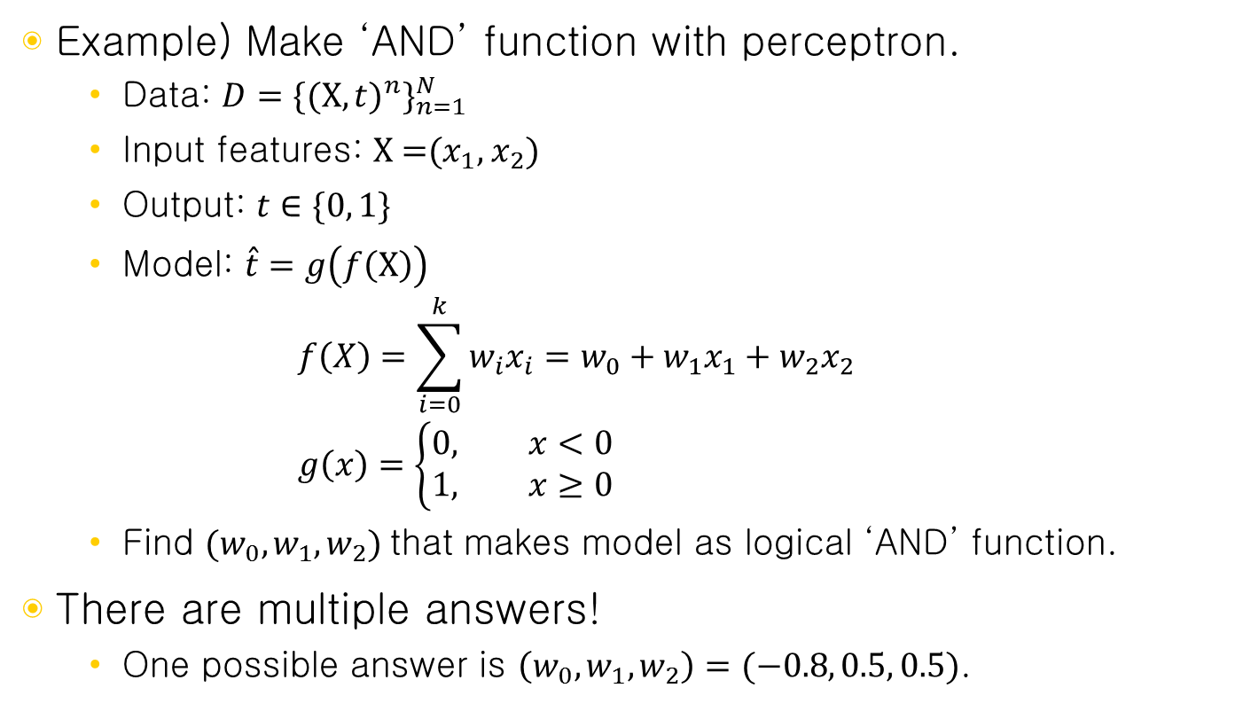
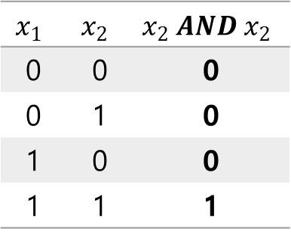
Perceptron(퍼셉트론)
Example) Make ‘AND’ function with perceptron.
Data: ${D=\{{(\text{X},t)}^{n}\}}_{n=1}^{N}$
Input features: $\text{X}\text{ =(}x_{1}\text{, }x_{2}\text{)}$
Output: $t∈\{0, 1\}$
Model: $\hat{t}=g\left(f\left(\text{X}\right)\right)$ $f\left(X\right)=\sum_{i=0}^{k}{w_{i}x_{i}}=w_{0}+w_{1}x_{1}+w_{2}x_{2}$ $g\left(x\right)=\left\{\begin{aligned}0, x<0 \\ &1, x≥0\end{aligned}\right.$
Find $(w_{0},w_{1},w_{2})$ that makes model as logical ‘AND’ function.
There are multiple answers!
One possible answer is $\left(w_{0},w_{1},w_{2}\right)=(−0.8, 0.5, 0.5)$.
$$x_{1}$$ | $$x_{2}$$ | $$x_{2} AND x_{2}$$
0 | 0 | 0
0 | 1 | 0
1 | 0 | 0
1 | 1 | 1

Slide 9
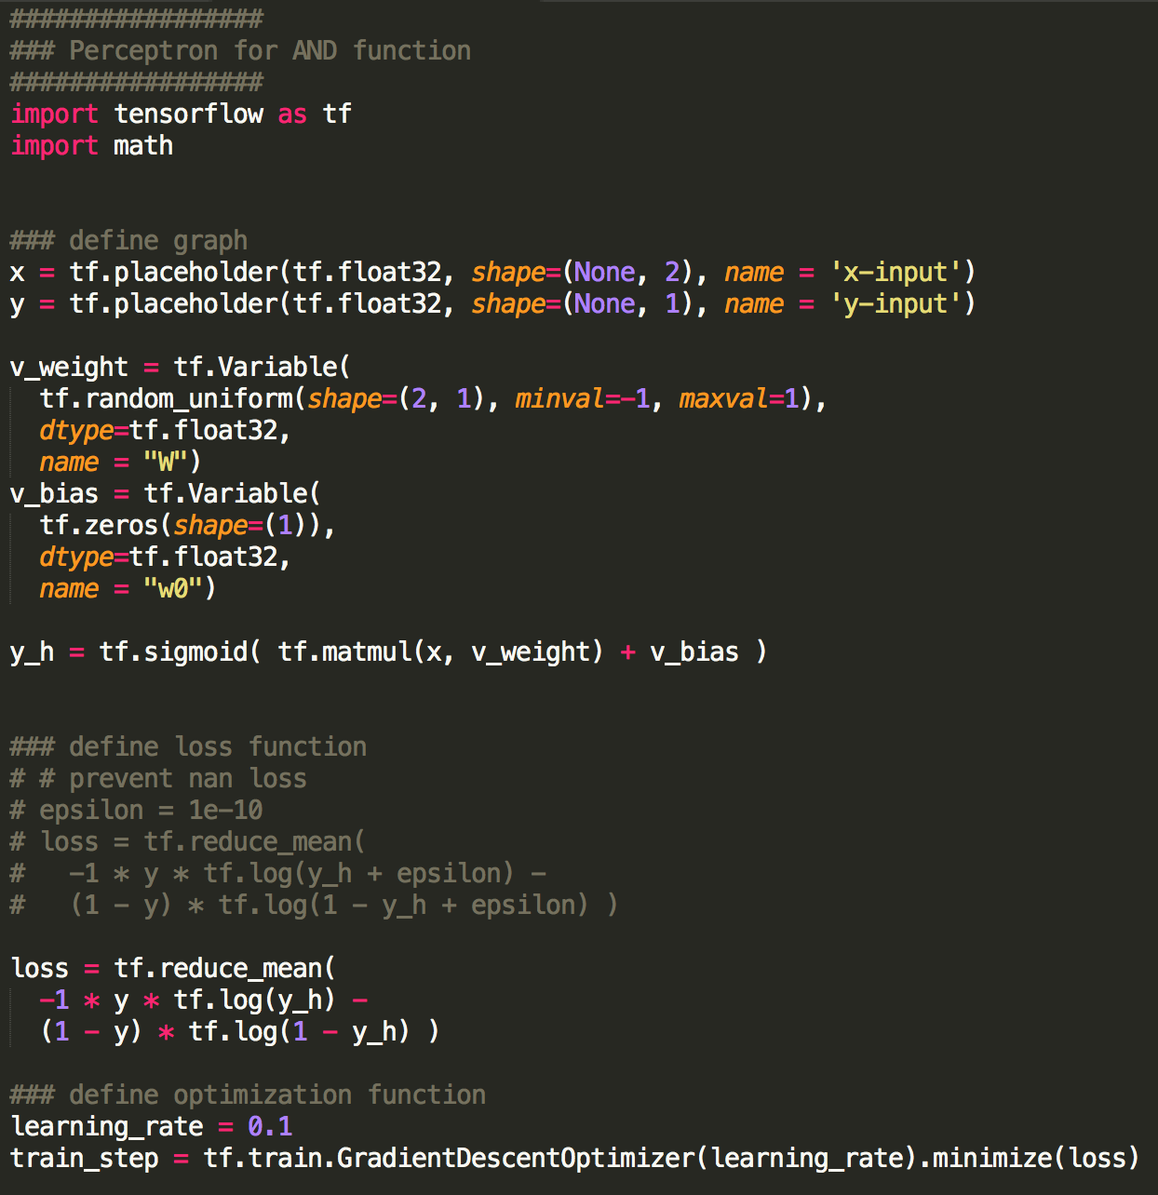
Implement ’AND’ function

Slide 10
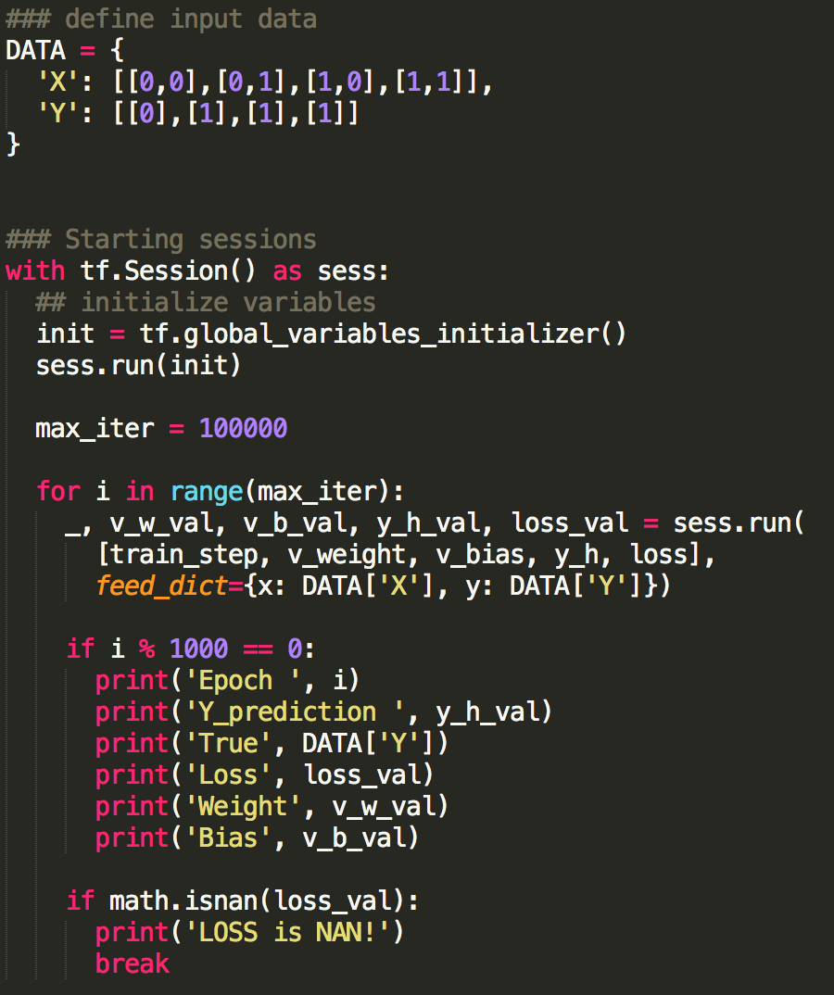
Implement ’AND’ function

Slide 11
Perceptron Exercise.
Change previous code to learn ’OR’ function.
Change previous code to learn ’XOR’ function?

Slide 12
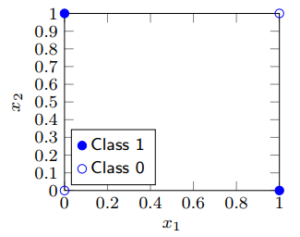
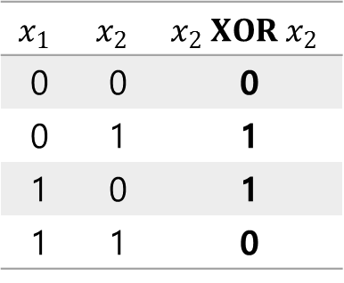
Perceptron(퍼셉트론)
Then, can perceptron model ‘XOR’ function?
No, it cannot.
To do so, we can separate two classes by drawing a single line on the plot. However, it is not possible.
Perceptron cannot model non linearly separable data!
Multilayer perceptron can represent more complex models.
$$x_{1}$$ | $$x_{2}$$ | $$x_{2} XOR x_{2}$$
0 | 0 | 0
0 | 1 | 1
1 | 0 | 1
1 | 1 | 0

Slide 13
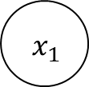
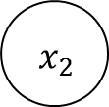
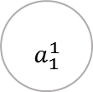
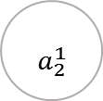
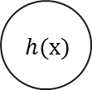
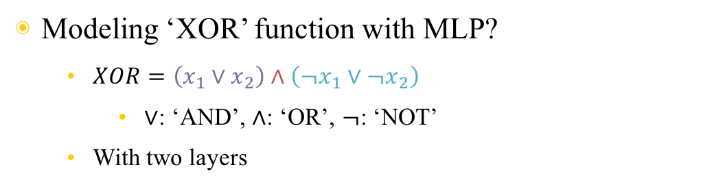
Multilayer perceptron(MLP)
Modeling ‘XOR’ function with MLP?
$XOR=\left(x_{1}∨x_{2}\right)∧\left(¬x_{1}∨¬x_{2}\right)$
$∨$: ‘AND’, $∧$: ‘OR’, $¬$: ‘NOT’
With two layers
$$x_{1}$$ | $$x_{2}$$ | $$x_{2} XOR x_{2}$$
0 | 0 | 0
0 | 1 | 1
1 | 0 | 1
1 | 1 | 0
+1
+1
$${ x}_{1}$$
$${ }_{a_{1}^{1}}$$
$$h(x)$$
$${ x}_{2}$$
$${ }_{a_{2}^{1}}$$

Slide 14
Perceptron Exercise.
Change previous code to learn ’XOR’ function.
By adding additional layer.

Slide 15
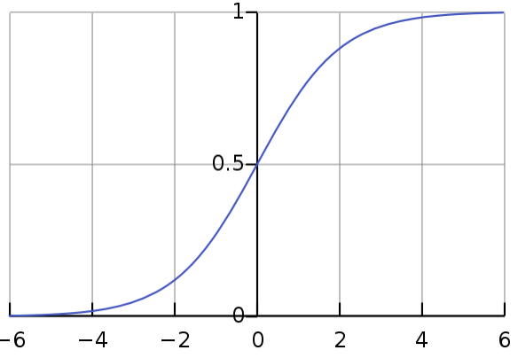
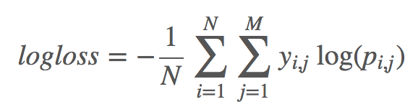

Multiclass-classification
Logistic loss -> softmax loss
Sigmoid (logistic): $σ\left(x\right)=\frac{1}{1+e^{−x}}=\frac{e^{x}}{e^{x}+1}$
Softmax: ${σ(Χ)}_{j}=\frac{e^{X_{j}}}{\sum_{i}{e^{X_{i}}}}$
Cross entropy

Slide 16
Neural network for real data
Iris data from sklearn.dataset
Multiclass-classification problem.
3 classes.
4 features.
150 samples.

Slide 17
Neural network Exercise.
Build new model.
Consists of four hidden layers.
Each layer consists of (10, 20, 10, 20) units with biases.
Does accuracy increase or decrease?
Explain why.

